Slide 1

BCDSS – SME Meeting
June 10, 2016

Slide 2
BCDSS – SME Meeting Attendance
Office SME |  | Name |  | Attendance
Veteran Health Administration Innovations Program
Innovation Coordinator | Heath A. Forney
OSP Liaison | Edward L Wells
Product Owner | Elizabeth Wollin
OBPI Representative | Kaitlin Conron
Comp Services | Matthew Padula
Comp Services | Paul J Shute
SME | VILAYPHONG SENTHEP
OBPI Representative | Karla Leal
Pro Sphere (BCDSS) | Bhupinder Pal. Singh
Pro Sphere (BCDSS) | Chiranjeevi Puttaswamy
Pro Sphere (BCDSS) | Darrell Dorman
PWS (BCDSS) | David Teague
Pro Sphere (BCDSS) | Dominic Yeh
Pro Sphere (BCDSS) | Erik Rothwell
Pro Sphere (BCDSS) | Ganesh Panneer
Pro Sphere (BCDSS) | Jeffrey Bamba
Pro Sphere (BCDSS) | Rebecca Garcia DeJesus
Pro Sphere (BCDSS) | Vasudeva Rayapati

Slide 3
BCDSS – SME Meeting Agenda
Discussions from previous meeting
Demonstrations of Login Screens
Modeling Agent's work flow walkthrough - CJ
Questions

Slide 4
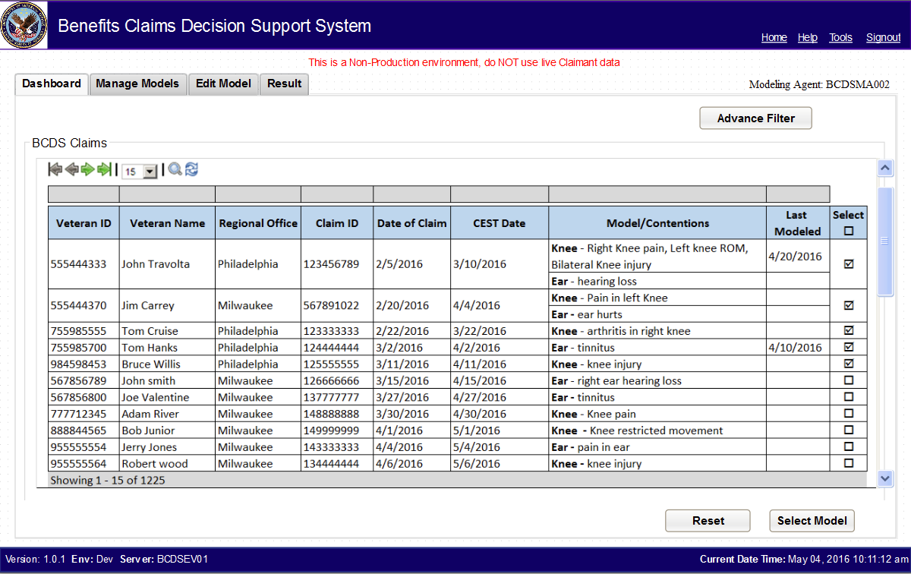
BCDSS – SME Meeting Modeling Agent's work flow walkthrough

Slide 5
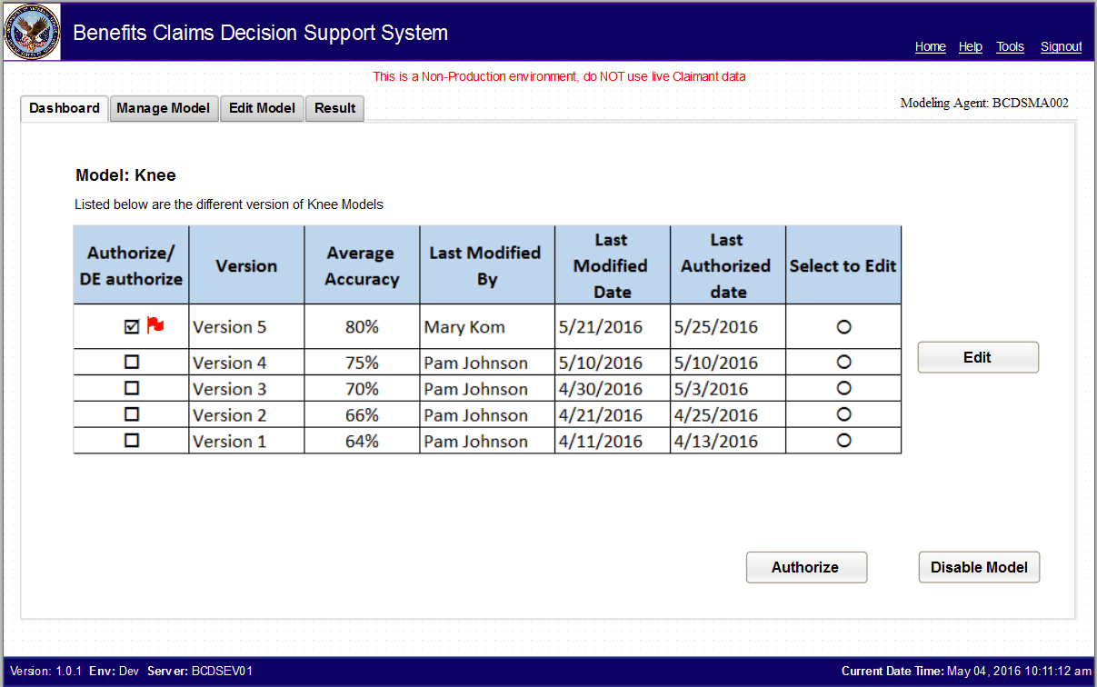
BCDSS – SME Meeting Modeling Agent's work flow walkthrough

Slide 6
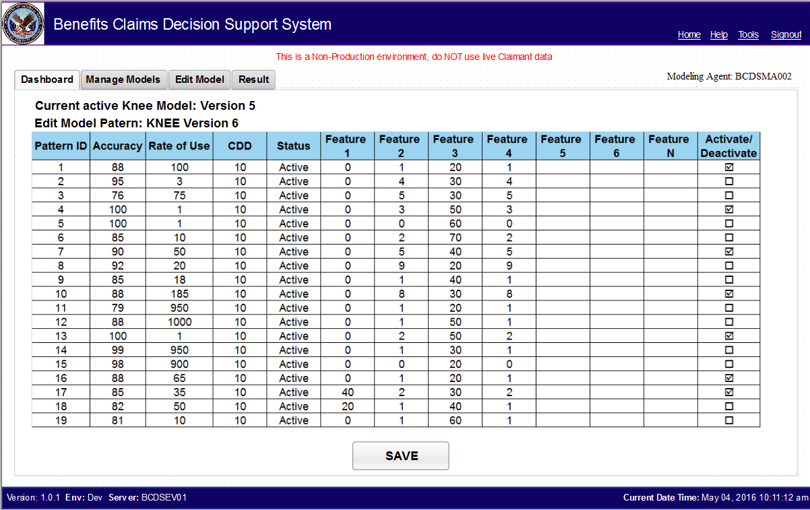
BCDSS – SME Meeting Modeling Agent's work flow walkthrough

Slide 7
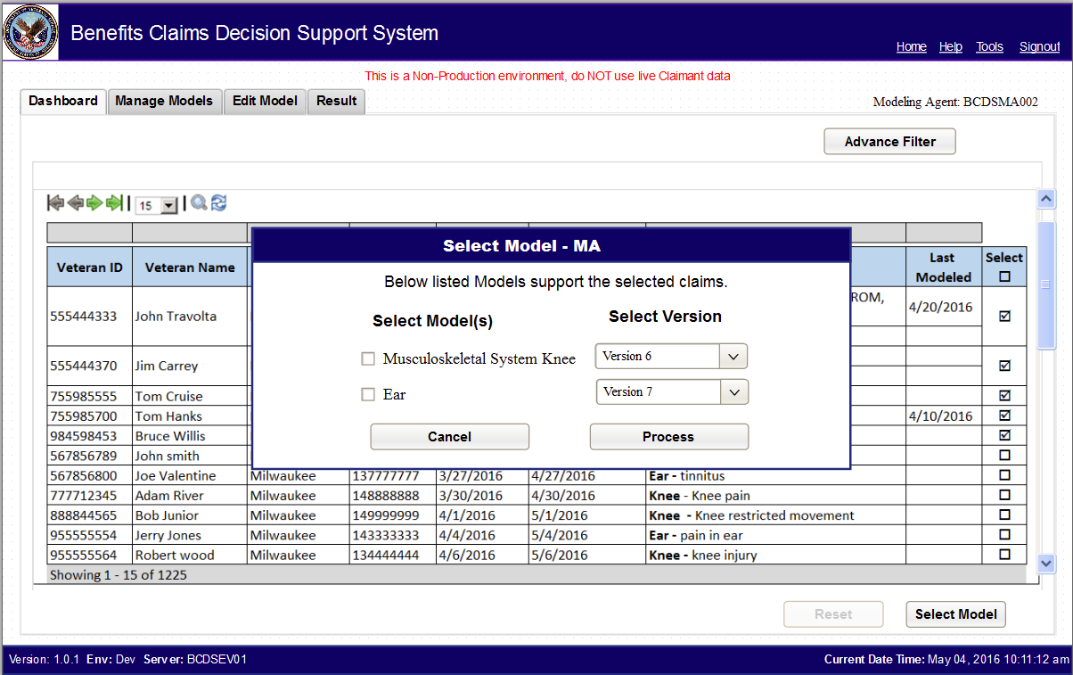
BCDSS – SME Meeting Modeling Agent's work flow walkthrough

Slide 8
BCDSS – SME Meeting Action Items
Action Items from 05/20/2016
Date of Contention – should be addressed in a different way
Action Items from 06/02/2016
None
Action Items from 06/10/2016
Will there ever be more than one Authorized Version in the system?
No, there won't be a situation
Authorize/De-Authorize should be a radio button
Much better way of displaying the buttons, also - the whole process of Authorize/De-Authorize - should be more restricted
Yes, it will be a restricted process
Not many will be given that role to manage the models
Patterns - Activate / Deactivate should be check boxes

Slide 9
BCDSS – SME Meeting Questions
?

Slide 10
BCDSS – SME Meeting
Thank you!

